Slide 1
Development Tools setup
Jim Wright
Stealth 4089

Slide 2
Parts you will need
The FRC 2018 Update package
RoboRio image tool
RoboRio firmware update
Java JRE installer
Driver Station
Eclipse Development Tool
Language specific parts

Slide 3
Documents
http://wpilib.screenstepslive.com/s/currentCS
Google ‘FRC Robot 2018 Software Install’
https://github.com/JimWright4089
https://github.com/JimWright4089/FIRSTWorkshops/tree/master/FRC/2017

Slide 4
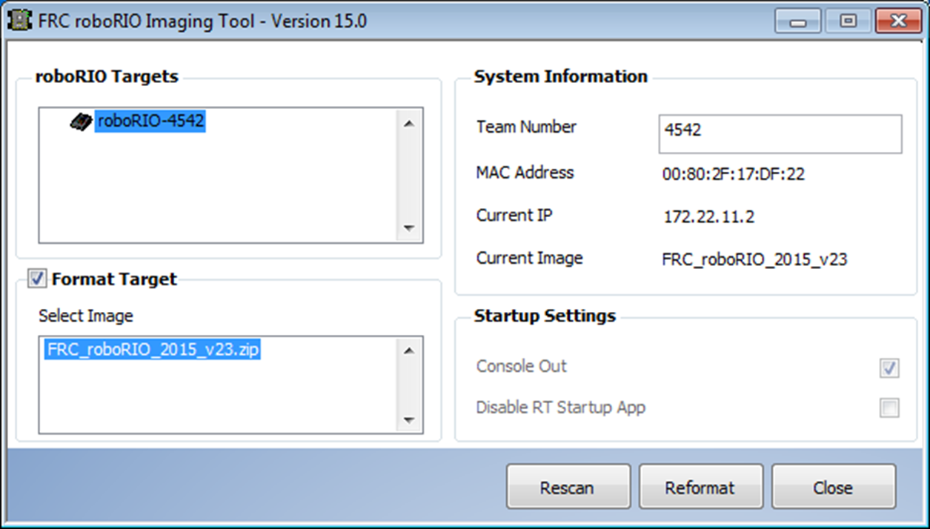
Robo Rio Image TOOL
Use this twice at least.
Once at the start of the build.
Second when you put the robot in the bag

Slide 5
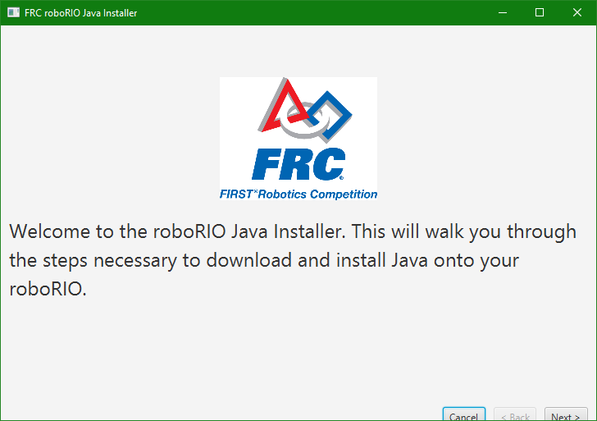
Java JRE install
It is hidden:
C:\Users\james\wpilib\tools
Put the shortcut for java-installer.jar on the desktop.
Running the first time you will need to download the JRE. There are steps in the tool for this. Once this is downloaded then the tool can read it from the last run.

Slide 6
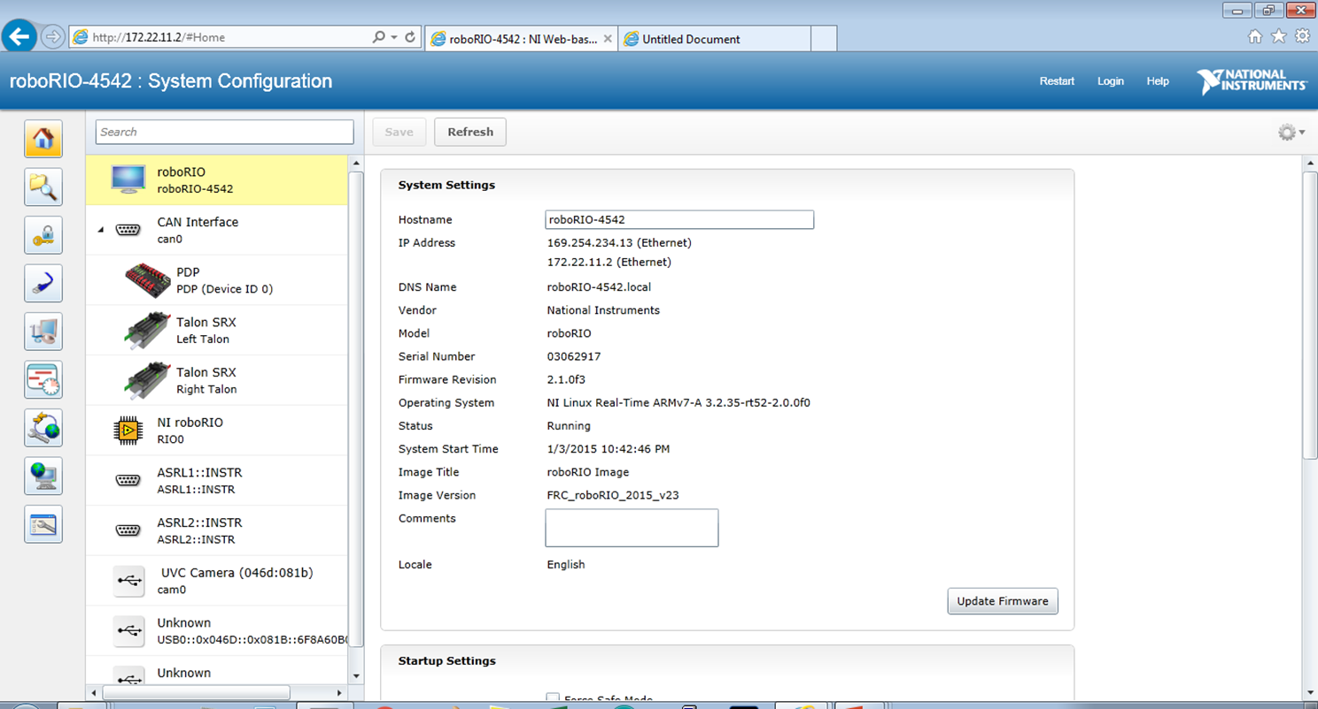
Roborio config tools
The most critical panel, and it’s the hardest to run. It needs Silverlight and most browsers don’t support it anymore.
On my Windows 10 machine I.E. is the browsers that I can only use.

Slide 7
Roborio config tools
The place to update the power distribution board firmware.
Configure the Talan SRXs
Checks for IP addresses
Checks the camera is connected and working.

Slide 8
Radio Config tools
Tricky to use.
Beginning 2017 this tool would not work for several types of laptop. This has been fixed.
Radios NEED firmware. The radio NEEDS to be rebooted during the loading.
Run this tool after all of the events are over and you are showing the robot during summer.

Slide 9
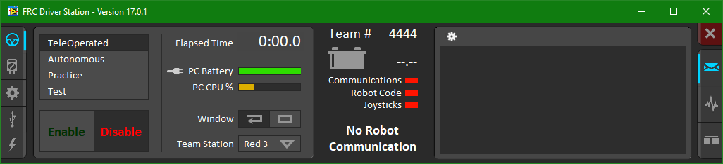
Driver station
You will use this in testing and during the events. The left icons are used to set the team number. Robot Inspectors are going to use the second icon down to find version numbers.
The USB panel configures controllers

Slide 10
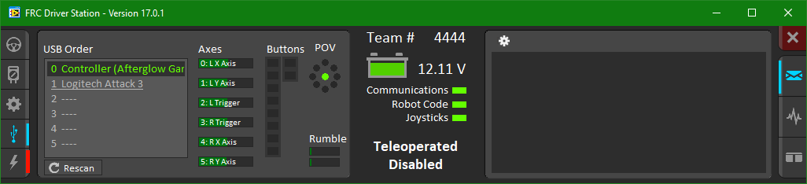
Driver station
Joystick config tool will help you find out the raw axes number. The buttons are also in order.

Slide 11
Driver station
The console and logs can be found here.

Slide 12
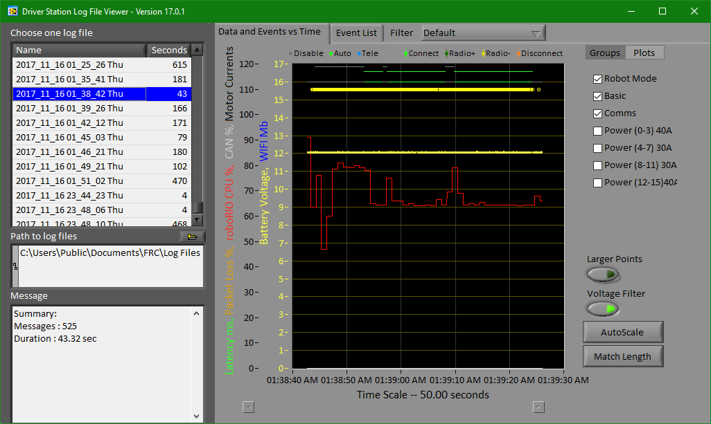
Driver station
Log file

Slide 13
Dashboard (default)

Slide 14
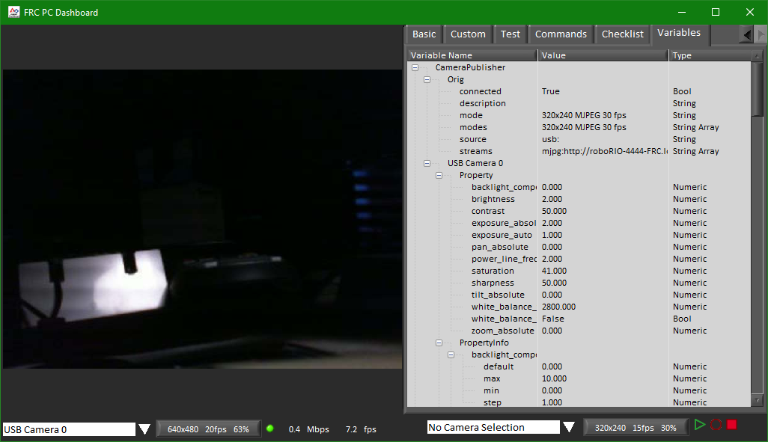
Dashboard (default) Network tables

